Slide 1

Blazor
Building Reusable Component Libraries
https://github.com/hikalkan/presentations

Slide 2
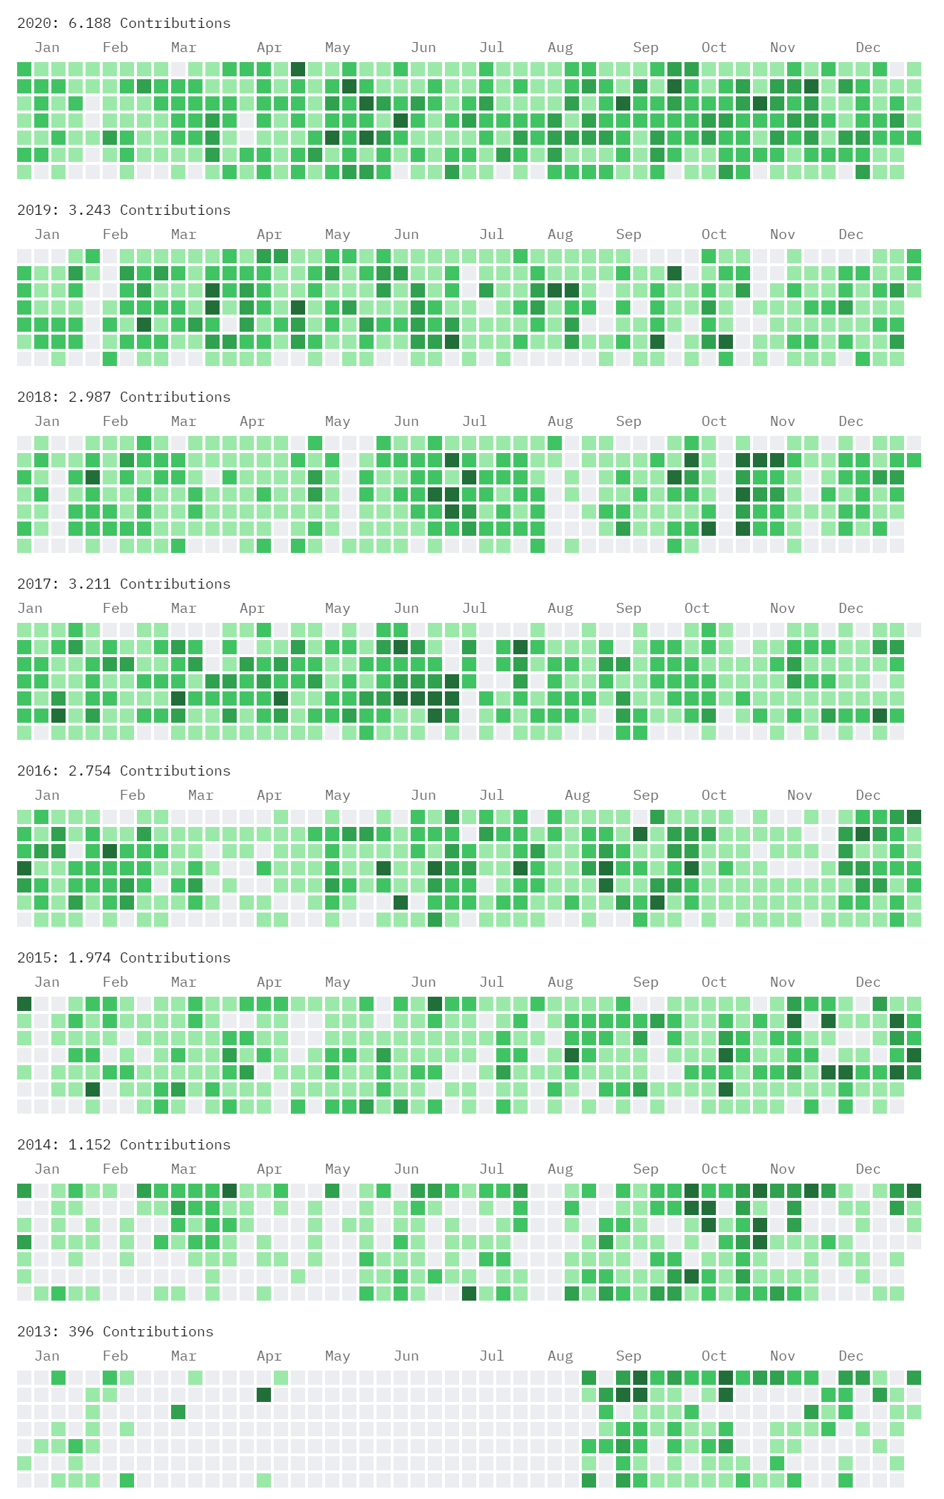


ABOUT ME Halil İbrahim Kalkan
Co-Founder of
Web: halilibrahimkalkan.com
Github: @hikalkan
Twitter: @hibrahimkalkan

Slide 3
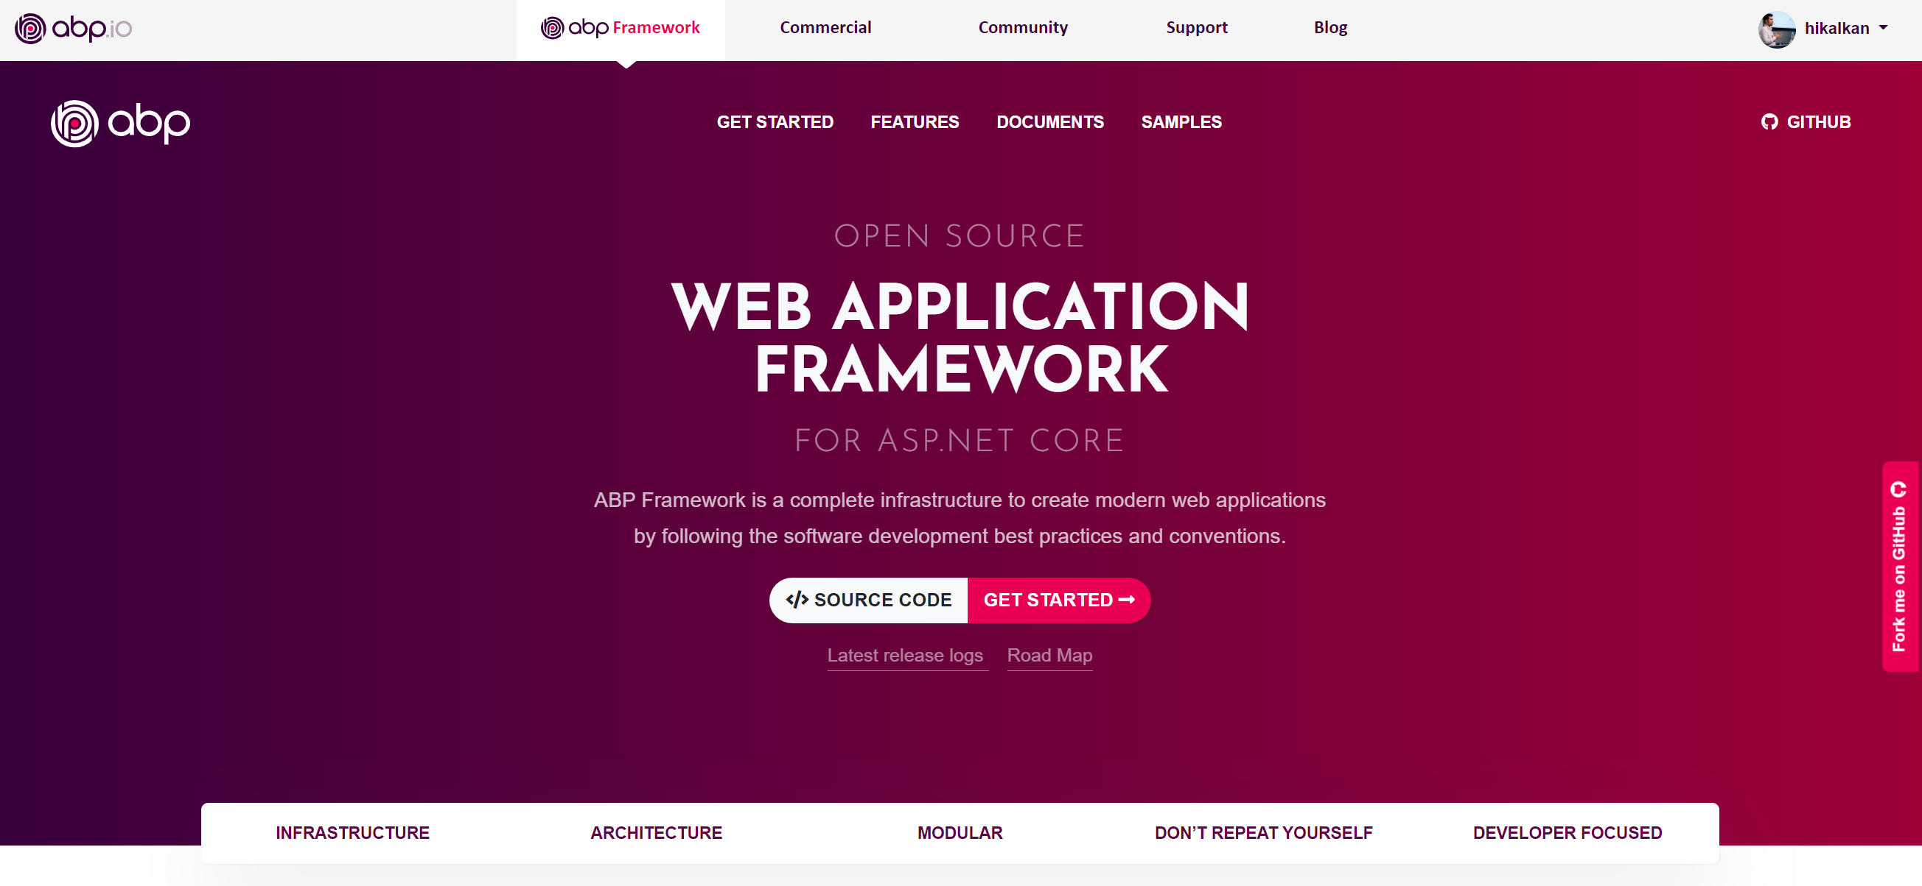
ABP Framework https://abp.io

Slide 4
What is Blazor?
Pros
C# instead of JavaScript
.NET platform runs on the Browser over WebAssembly
All the .NET Ecosystem (NuGet packages) in the client side!
Code sharing (DTOs, validation logic, utils…) between client & server.
JavaScript Interop
Cons
Initial Load & Runtime performance
Limited Debugging
UI Component libraries are not mature & rich.

Slide 5
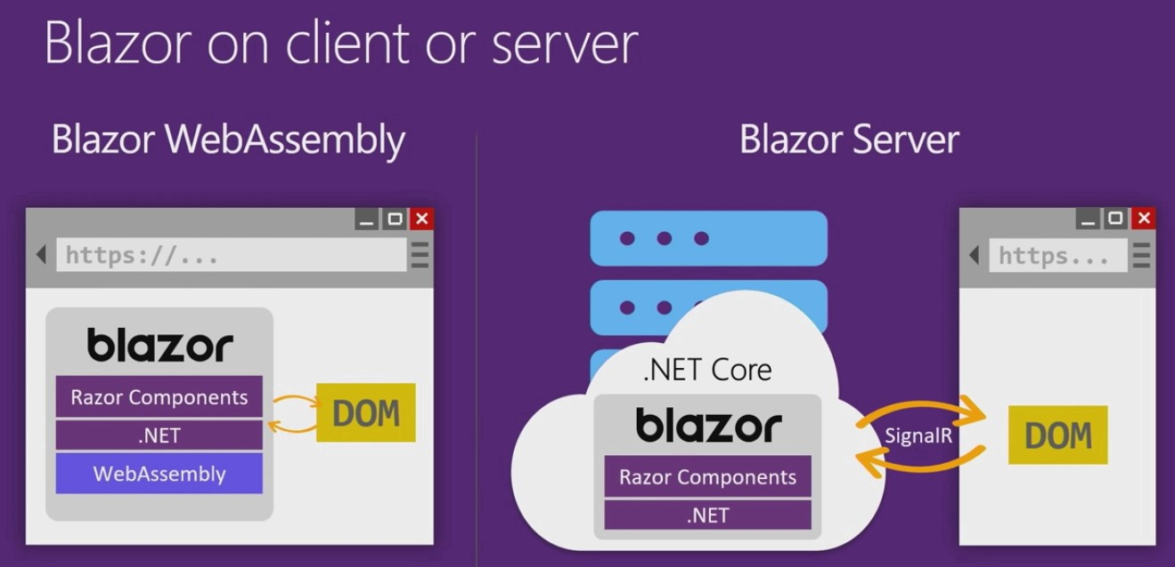

Slide 6
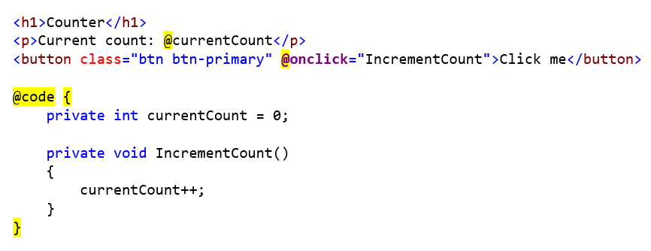
Blazor: Razor Components

Slide 7
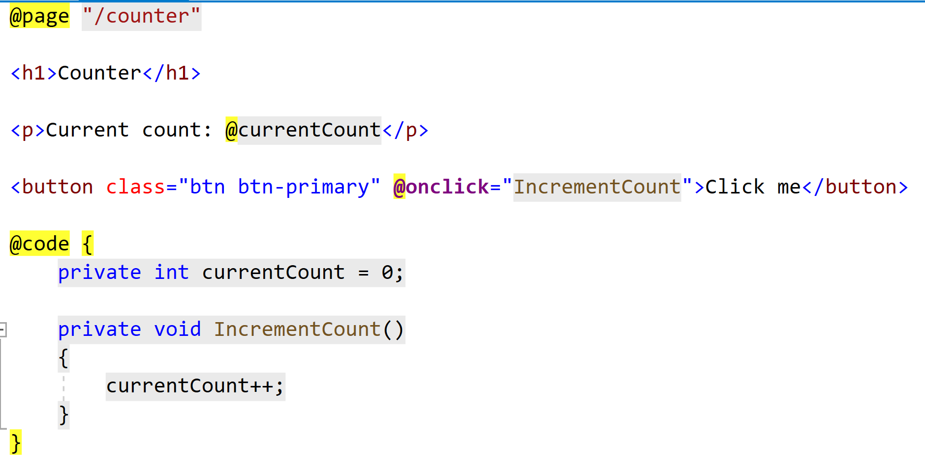
@page directive

Slide 8
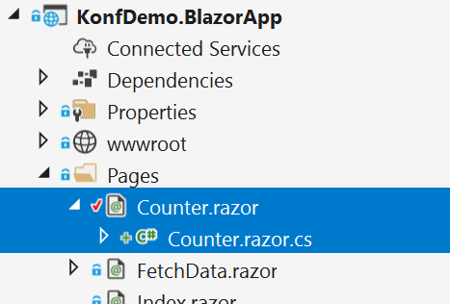
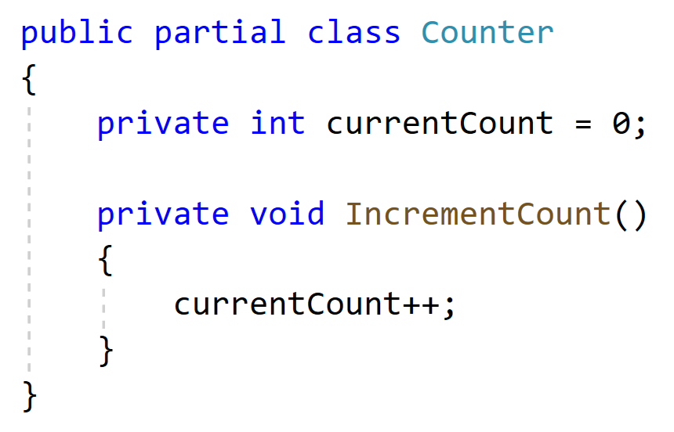
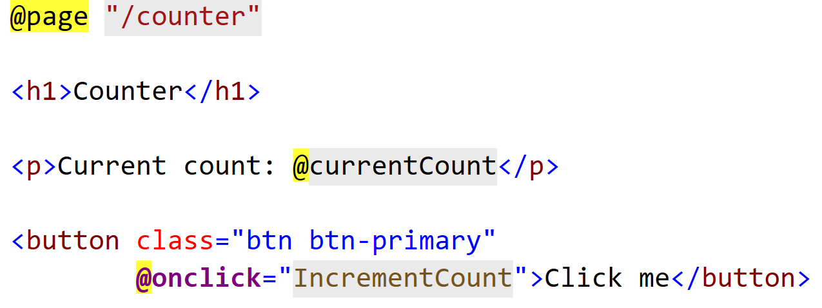
Code Behind (Partial Class)
Counter.razor
Counter.razor.cs

Slide 9
LIVE CODING!

Slide 10
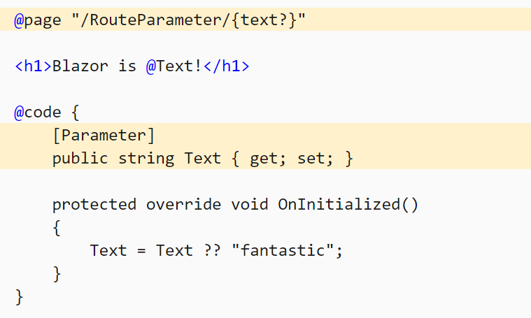
Route Parameters

Slide 11
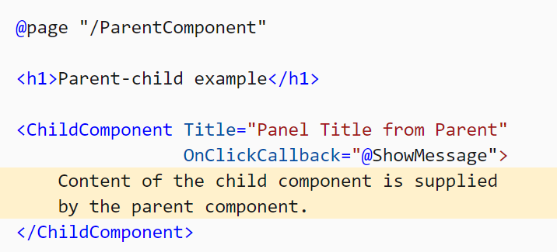
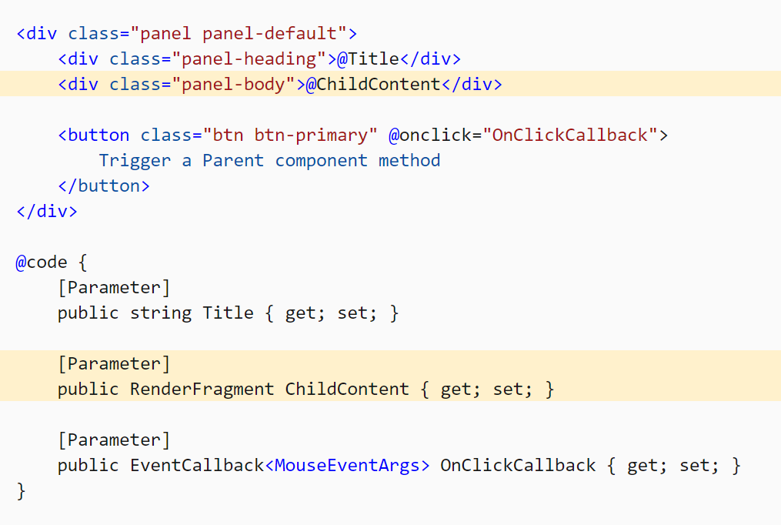
Child Component

